Slide 1
The Rape of Nanjing

Slide 2
Overview
Occurred in 1937 during the Sino-Japanese War. The Imperial Japanese Army attacked Nanjing, which was the capital of Nationalist China.
December 1, 1937 - Chiang Kai-Shek withdrew his troops and the Chinese government abandoned Nanjing left the International Committee for the Nanjing Safety Zone in charge.
December 13, 1937 - Japan's Central China Front Army entered the city. Chinese soldiers were killed by the thousands, the elderly and infants were executed, and tens of thousands of women were raped. One-third of Nanjing's buildings were looted and burned.
January, 1938 - Order had been declared restored in the city. However, killings continued until the first week of February.
An estimated 200,000 to 300,000 people died in the massacre, and about 20,000 - 80,000 women were sexually assaulted. The Nanjing Massacre still affects Sino-Japanese relations today.

Slide 3
Preparing For Invasion
Following a bloody victory in Shanghai during the Sino-Japanese War, the Japanese turned their attention towards Nanjing. Fearful of losing them in battle, Nationalist leader Chiang Kai-Shek ordered the removal of nearly all official Chinese troops from the city, leaving it defended by untrained auxiliary troops. Chiang also ordered the city held at any cost, and forbade the official evacuation of its citizens. Many ignored this order and fled, but the rest were left to the mercy of the approaching enemy.
A small group of Western businessmen and missionaries, the International Committee for the Nanjing Safety Zone, attempted to set up a neutral area of the city that would provide refuge for Nanjing’s citizens. The safety zone, opened in November 1937, was roughly the size of New York’s Central Park and consisted of more than a dozen small refugee camps. On December 1, the Chinese government abandoned Nanjing, leaving the International Committee in charge. All remaining citizens were ordered into the safety zone for their protection.

Slide 4
Arrival Of The Troops
On December 13, the first troops of Japan’s Central China Front Army, commanded by General Matsui Iwane, entered the city. Even before their arrival, word had begun spreading of the numerous atrocities they had committed on their way through China, including killing contests and pillaging. Chinese soldiers were hunted down and killed by the thousands, and left in mass graves. Entire families were massacred, and even the elderly and infants were targeted for execution, while tens of thousands of women were raped. Bodies littered the streets for months after the attack. Determined to destroy the city, the Japanese looted and burned at least one-third of Nanjing’s buildings.
Though the Japanese initially agreed to respect the Nanjing Safety Zone, ultimately not even these refugees were safe from the vicious attacks. In January 1938, the Japanese declared that order had been restored in the city, and dismantled the safety zone; killings continued until the first week of February. A puppet government was installed, which would rule Nanjing until the end of World War II.

Slide 5
Arrival Of The Troops
After this period of unprecedented violence, the Japanese eased off somewhat and settled in for the duration of the war. To pacify the population during the long occupation, highly addictive narcotics, including opium and heroin, were distributed by Japanese soldiers to the people of Nanking, regardless of age. An estimated 50,000 persons became addicted to heroin while many others lost themselves in the city's opium dens.
In addition, the notorious Comfort Women system was introduced which forced young Chinese women to become slave-prostitutes, existing solely for the sexual pleasure of Japanese soldiers.

Slide 6
!WARNING!
GRAPHIC CONTENT AHEAD

Slide 7
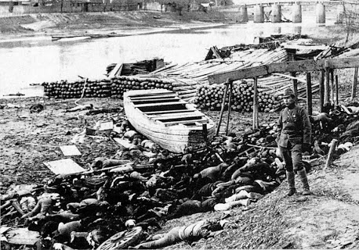

Slide 8
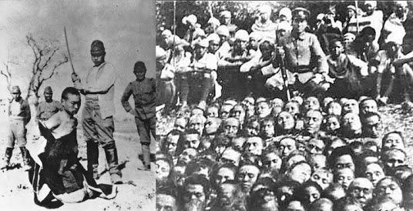

Slide 9
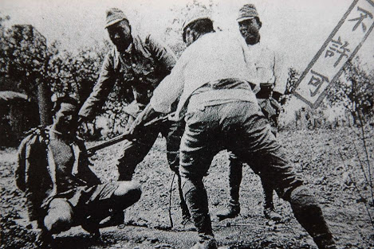

Slide 10
Aftermath Of The Massacre
There are no official numbers for the death toll in the Nanjing Massacre, though estimates range from 200,000 to 300,000 people. Soon after the end of the war, Matsui and his lieutenant Tani Hisao, were tried and convicted for war crimes by the International Military Tribunal for the Far East and were executed. Anger over the events at Nanjing continues to color Sino-Japanese relations to this day. The true nature of the massacre has been disputed and exploited for propaganda purposes by historical revisionists, apologists and Japanese nationalists. Some claim the numbers of deaths have been inflated, while others have denied that any massacre occurred.

Slide 11
Why It Happened
After four days of fighting, Japanese troops smashed into the city on December 13, 1937, with orders issued to "kill all captives."
Their first concern was to eliminate any threat from the 90,000 Chinese soldiers who surrendered. To the Japanese, surrender was an unthinkable act of cowardice and the ultimate violation of the rigid code of military honor drilled into them from childhood onward. Thus they looked upon Chinese POWs with utter contempt, viewing them as less than human, unworthy of life.
Eyewitness reports by Japanese military correspondents concerning the sufferings of the people of Nanking also appeared. They reflected a mentality in which the brutal dominance of subjugated or so-called inferior peoples was considered just.

Slide 12
Nanjing Massacre Memorial Hall
The Nanjing Memorial Hall was built in 1985 by the Nanjing Municipal Government in memory of the 300,000 victims who lost their lives during the Nanjing Massacre
It is located in the southwestern corner of Nanjing known as Jiangdongmen, near a site where thousands of bodies were buried, called a "pit of ten thousand corpses."

Slide 13
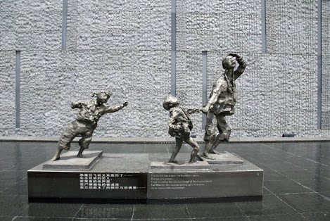
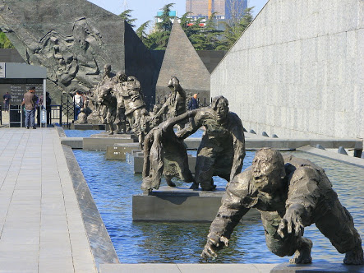
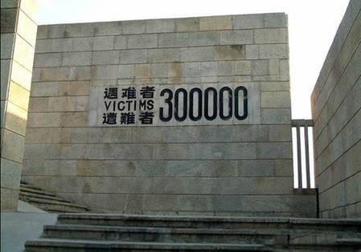

Slide 14
Video link: https://www.youtube.com/watch?v=l7QzyyD2gKY&t=31s

Slide 15
Sources:
http://www.history.com/topics/nanjing-massacre
https://en.wikipedia.org/wiki/Nanjing_Massacre_Memorial_Hall
https://www.youtube.com/watch?v=l7QzyyD2gKY&t=31s
http://www.historyplace.com/worldhistory/genocide/nanking.htm

